Slide 1
ECE 105: Introduction to Electrical Engineering
Lecture 1
Introduction to EE, and ECE 105
Yasser Khan
Rehan Kapadia

Slide 2
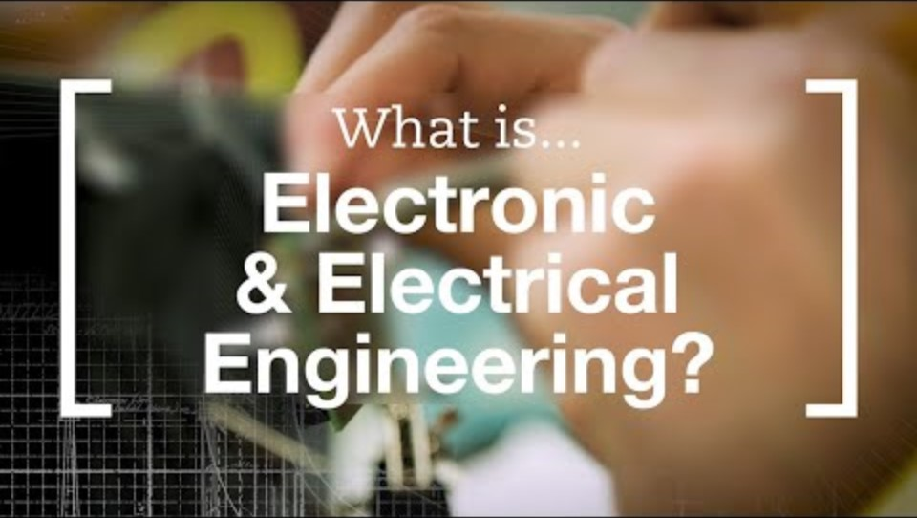
What is Electrical Engineering?
Electrical Engineering is an engineering discipline concerned with the study, design, and application of equipment, devices, and systems which use electricity, electronics, and electromagnetism.

Slide 3
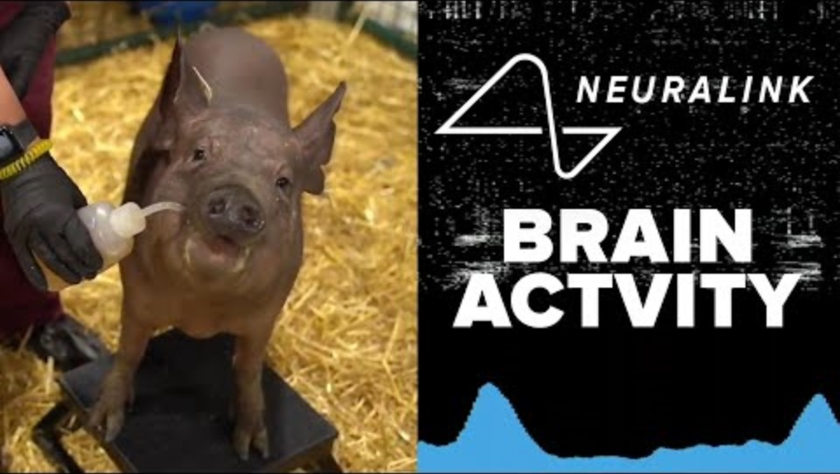
Let’s look at EE at play: 3 little pigs demo by Neuralink

Slide 4
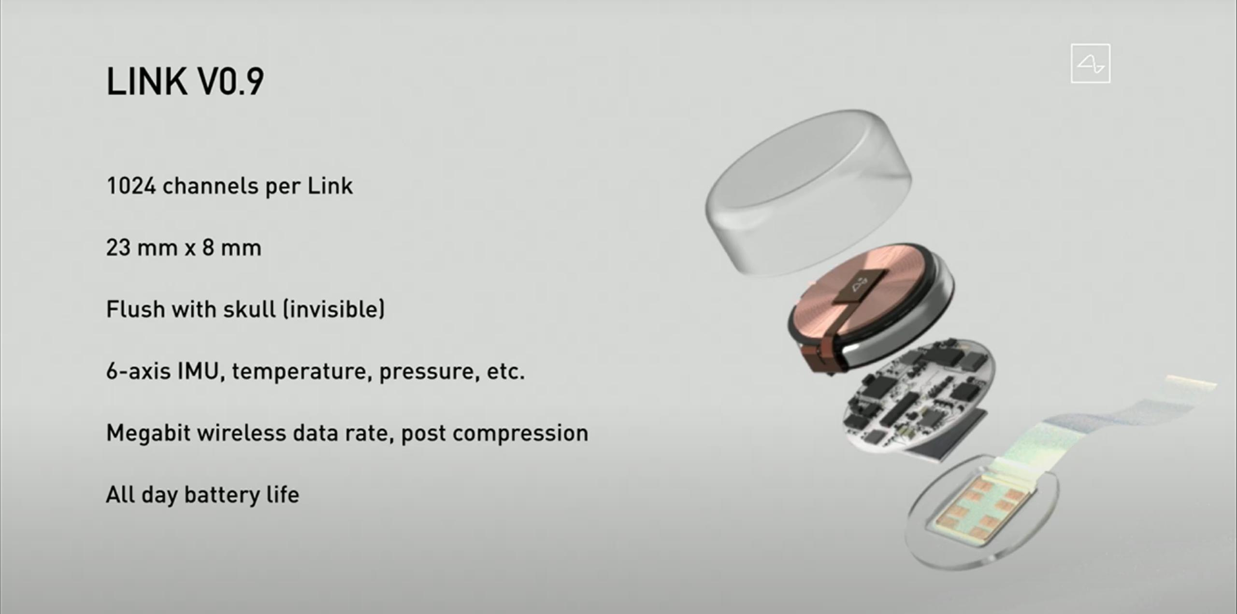
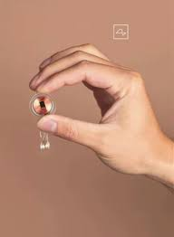
Neuralink – the neural implant
Every step of the neural implant design and fabrication requires electrical engineering

Slide 5
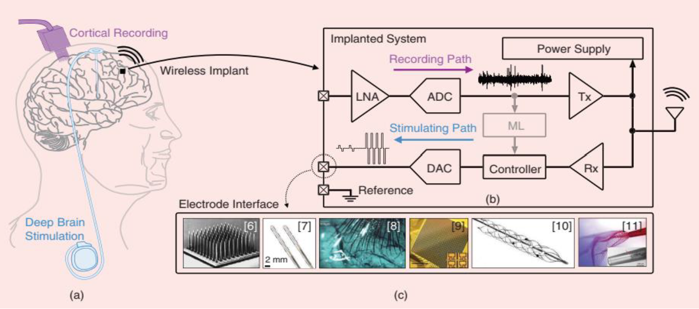
Neural interfaces – under the hood
(a) Two clinical neural interfaces: a percutaneous neural recording implant similar to [1], and a deep brain stimulator. (b) Components for an implantable bidirectional (black) or closed-loop (black and gray) wireless neural interface. (c) Example neural interface electrodes. [From left to right (adapted from Utah microelectrode array [6], SENSIGHT by Medtronic [7], ultrathin polymer threads by Neuralink [8], high-density neural matrix [9], Stentrode by Synchron [10], and ultraflexible syringe-injectable mesh [11]).] LNA: low-noise amplifier; ADC: analog-to-digital converter; Tx: transmitter; ML: machine learning; DAC: digital-to-analog converter; Rx: receiver.

Slide 6
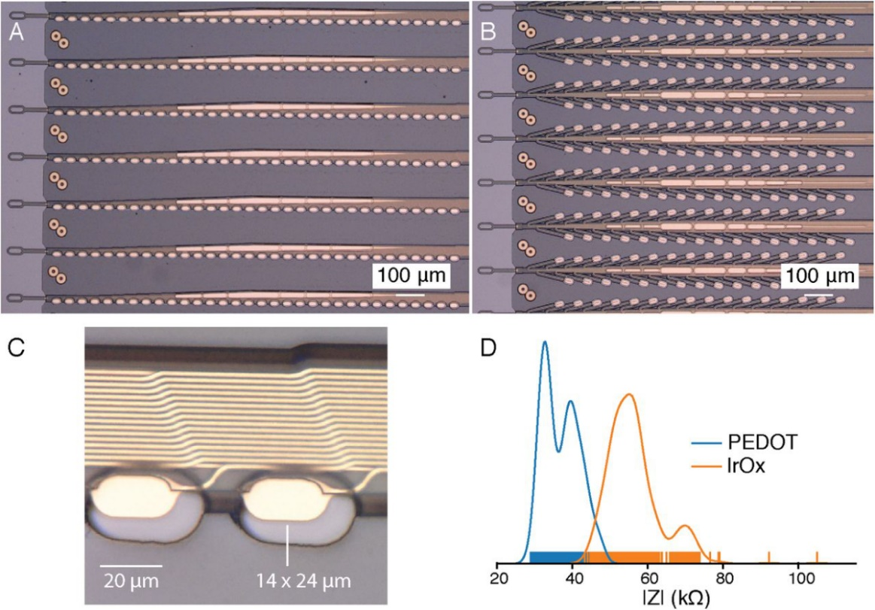
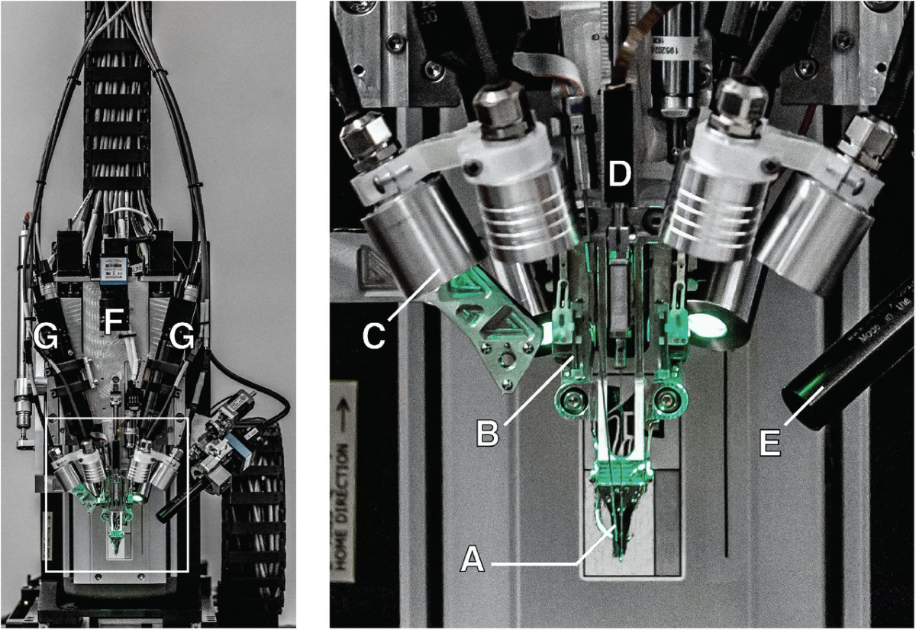
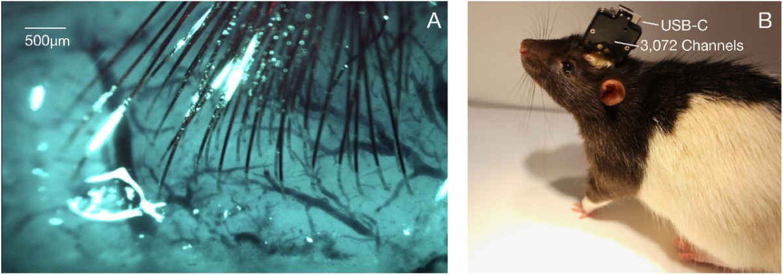
Link v0.9
Surgical robots need robotics, electrical engineering, mechanical engineering, control engineering
Sensors need electrical engineering, mechanical engineering, materials science, chemical engineering
Implants need electrical engineering, computer science

Slide 7
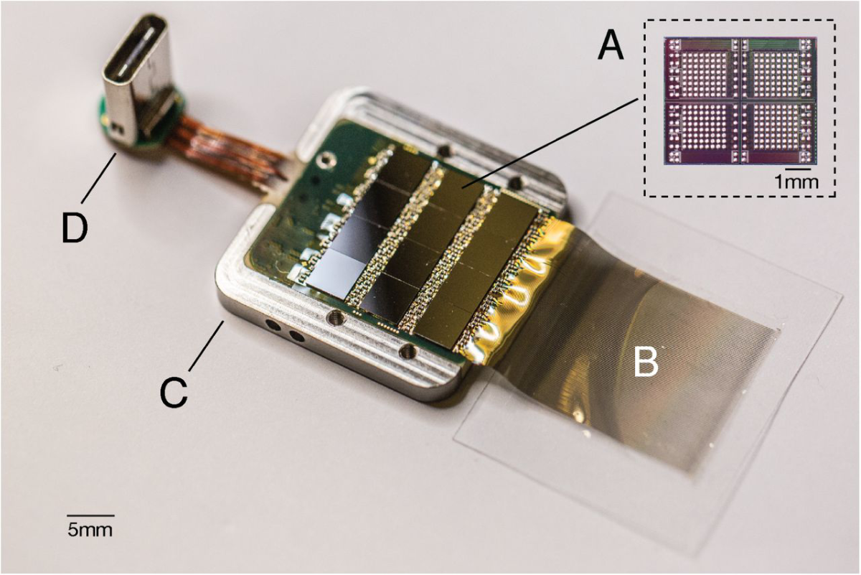
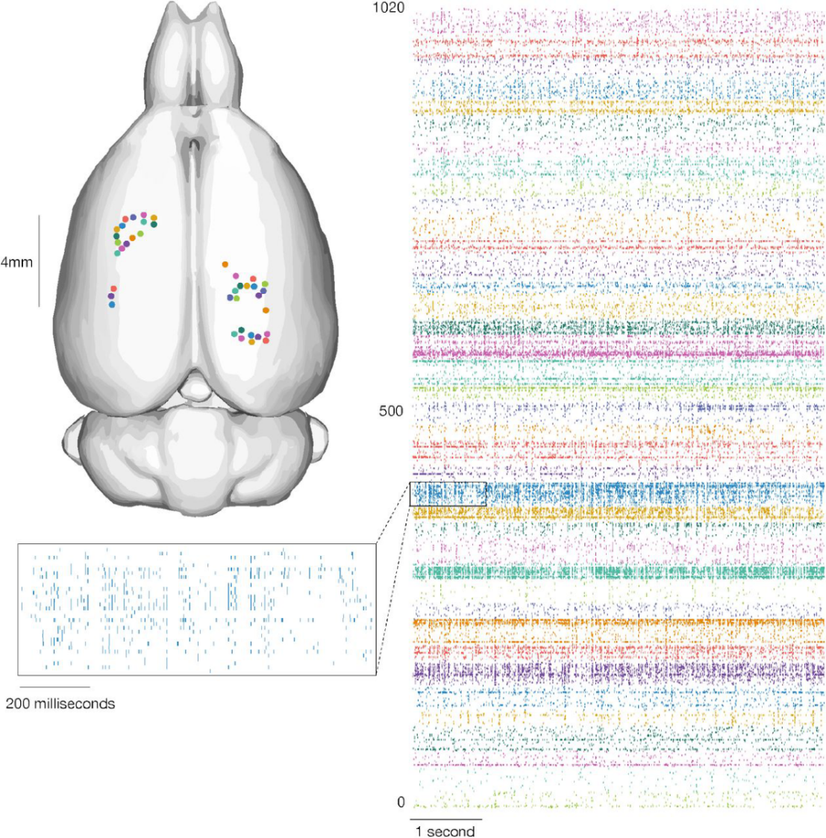
Brain recording from 1024 analog pixels
Each neural recording unit requires sensors, integrated circuits, communications, and power
Notes:
8x8 x4 x12 = 3072

Slide 8
What is currently driving computing?

Slide 9
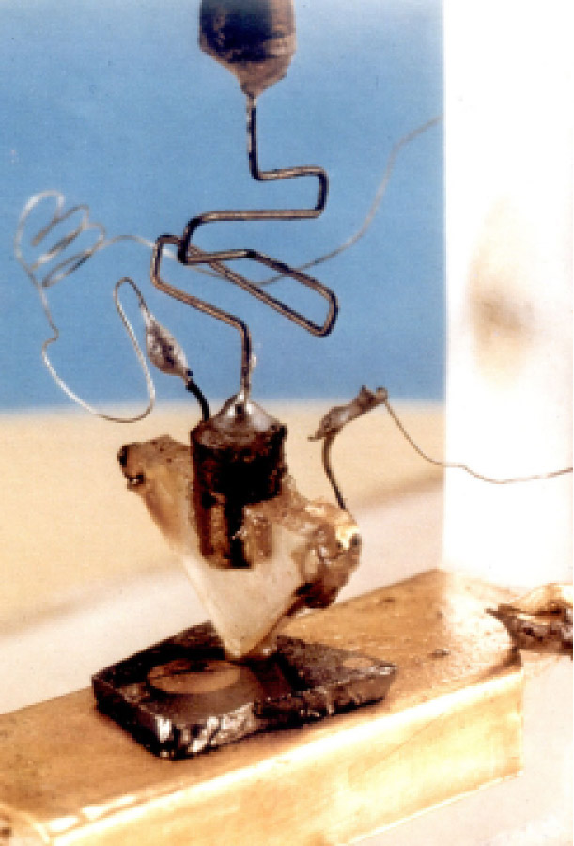
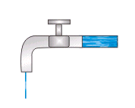
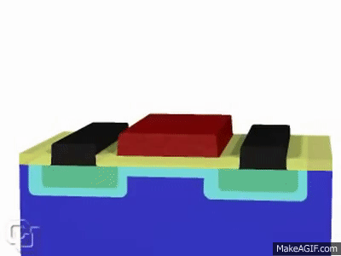
How do we carry out so much computing?
We use transistors!

Slide 10
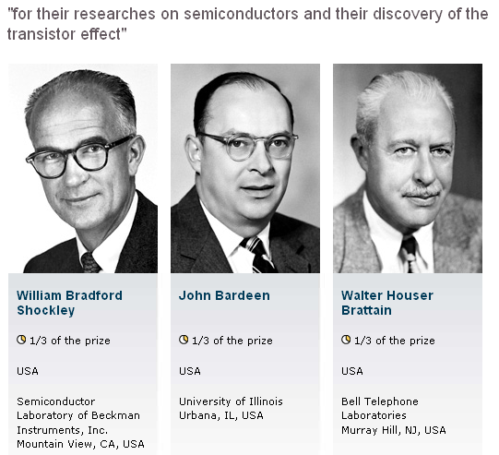
1956 Physics Nobel Prize

Slide 11
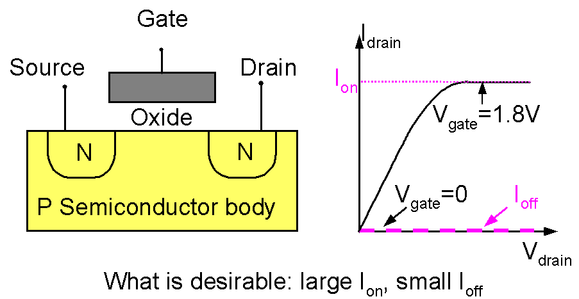
What is a transistor?

Slide 12
What is a transistor?
It acts as an on-off switch.
We want to switch it on and off as fast as possible.
We want to switch it on and off with as little power usage as possible.

Slide 13
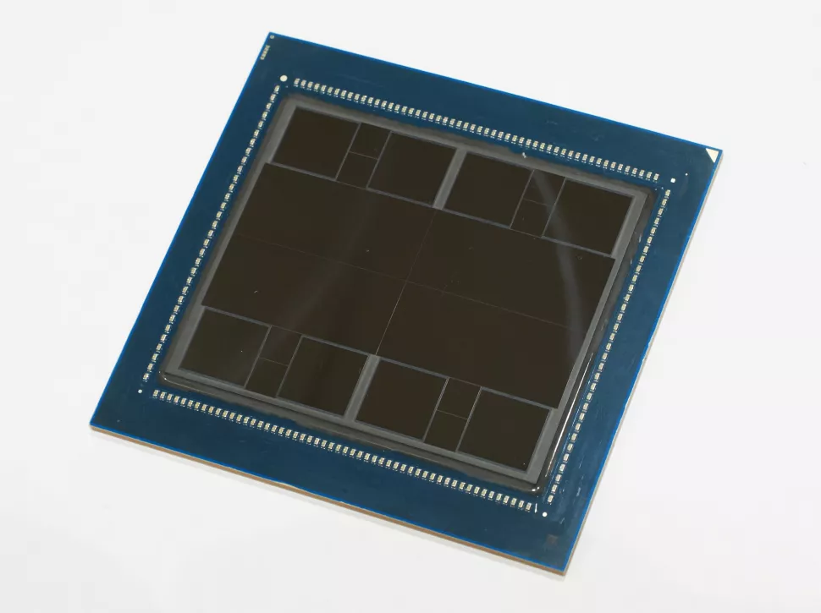
What do modern day integrated circuits look like?
Key points
Total of ~150 billion transistors
Uses 5 nm node technology
Density of transistors is ~130-230 million transistors/mm²
In the area of a cell , we could fit ~100k - 1 million transistors
Multiple parts of this processor use 3-D stacked dies
Enables computing, memory, sensing, and stimulation to be integrated together
Performance ~8x improved over previous MI250 Accelerator
If they upgraded the fastest supercomputer to this part, they could train the largest AI/ML systems
AMD Instinct MI300 Accelerator

Slide 14
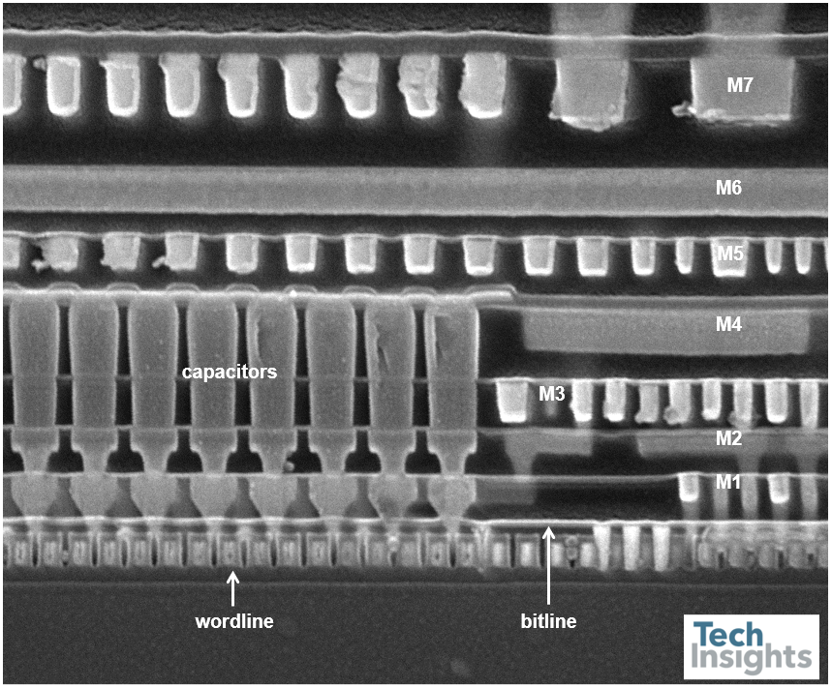
What do these look like?
Wires to connect all the transistors together
Active devices (silicon transistors)

Slide 15
How did we get here?

Slide 16
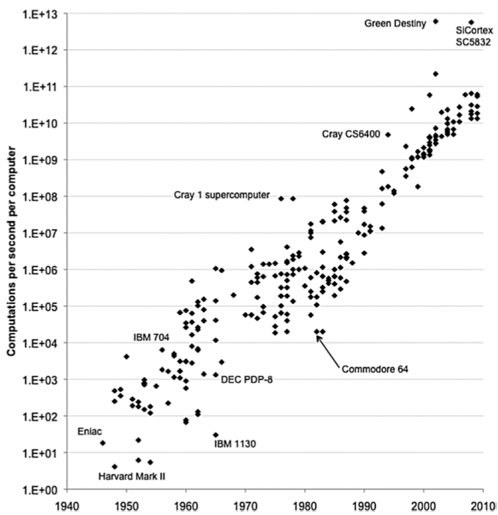
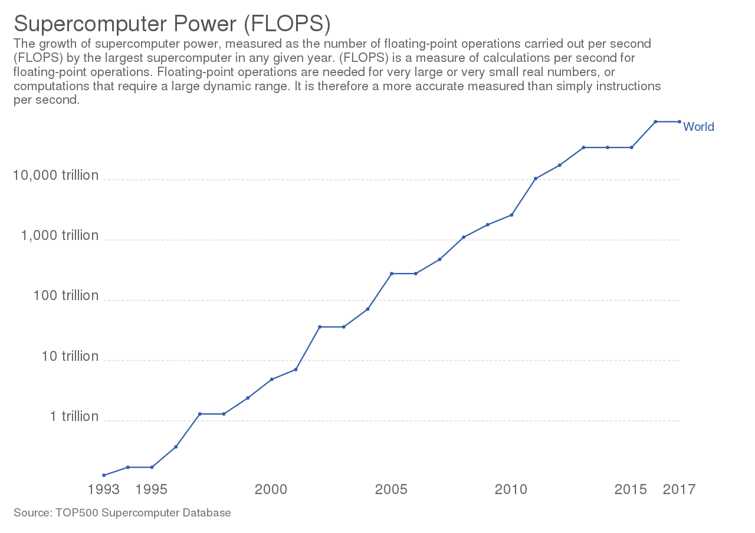
How much has computing power increased?
From 1990 to today, the worlds largest super computers have increased computing power by 100,000x
That’s a lot!
By Our World In Data - https://ourworldindata.org/grapher/supercomputer-power-flops

Slide 17
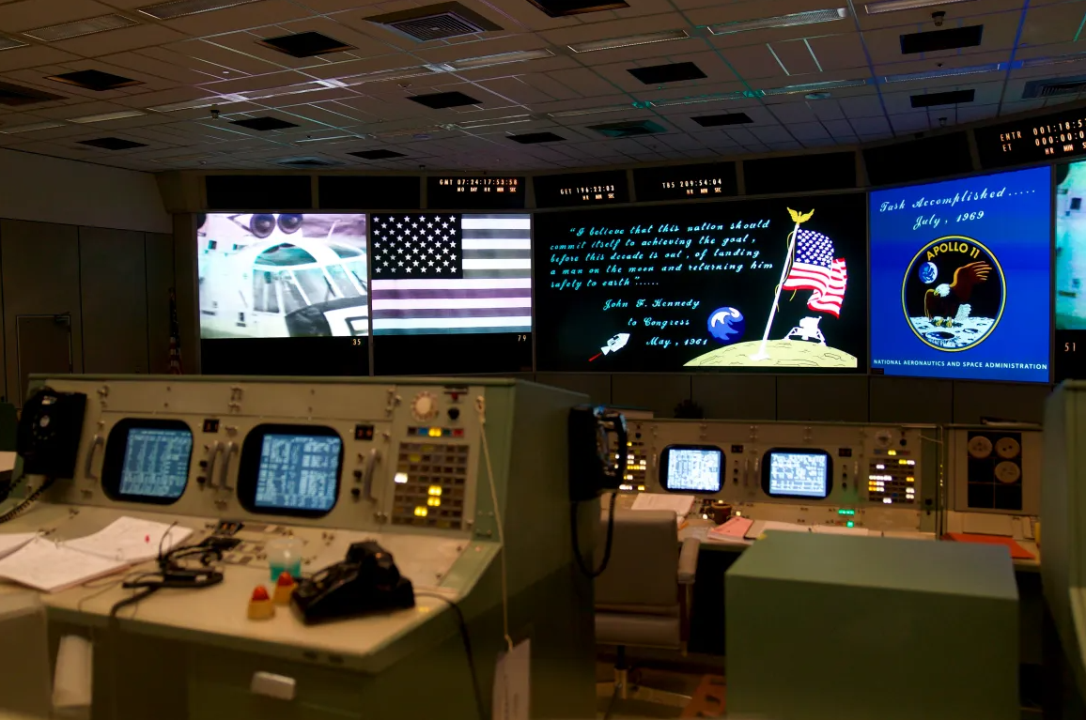
The First Moon Landing Was Achieved With Less Computing Power Than a Cell Phone or a Calculator
On board Apollo 11 was a computer called the Apollo Guidance Computer. It had 2,048 words of memory that could be used to store “temporary results”—data that is lost when there is no power. This type of memory is referred to as RAM (random access memory). Each word comprised 16 binary digits (bits), with a bit being a zero or a one. This means that the Apollo computer had 32,768 bits of RAM memory.
My computer has 64,000,000,000 bits of RAM memory
That is 2,000,000 times more than what was needed in Apollo 11.

Slide 18
How do we make transistors faster?

Slide 19
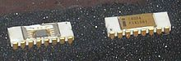
Scaling – How much have we scaled devices?
1971: The first commercial microprocessor…Intel 4004
4-bits
Less than 1 square inch in area
Transistors that were 10 micrometers long
~750 kilohertz speed
…but more powerful than the computers from earlier that weighed 30 tons
Let’s say that this is a scaled version of how long a transistor was in 1971

Slide 20
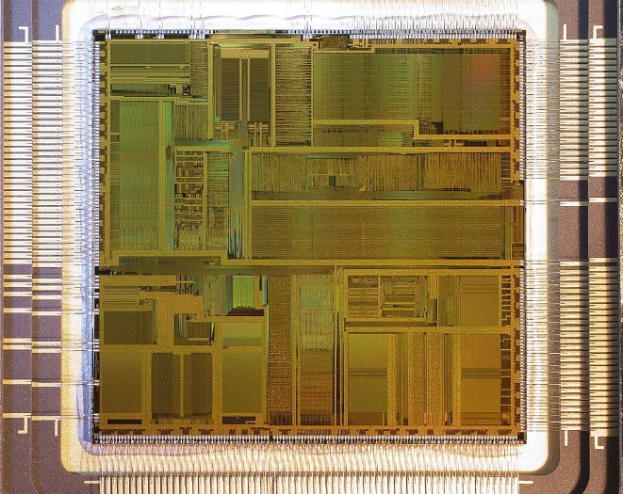
Scaling – How much have we scaled devices?
1990s: The first Pentium processor
66 MHz. That’s 100 times faster than in 1970.
Can you think of anything else that has improved by 100x in 20 years?
1971
1993

Slide 21
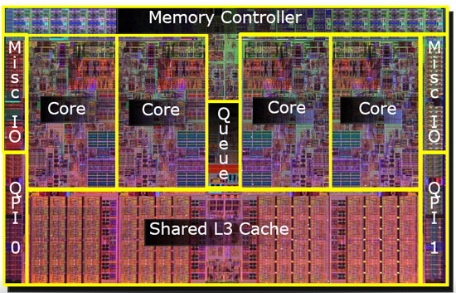
Scaling – How much have we scaled devices?
2012:
1-3 GhZ
Multi-core
Super-fast
Each transistor is almost 1000 times smaller!
1971
1993
Can’t even see the size on the screen…not enough pixels

Slide 22
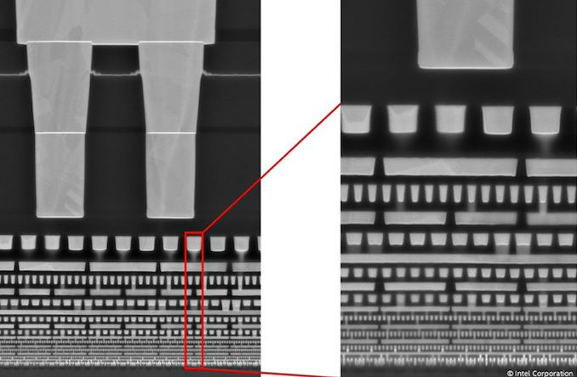
Scaling – How much have we scaled devices?
Intel 4 cross section: to be released 2023
What does a modern CPU cross section look like?
Where are the transistors?
What are we looking at?

Slide 23
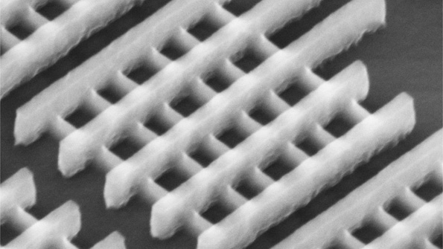
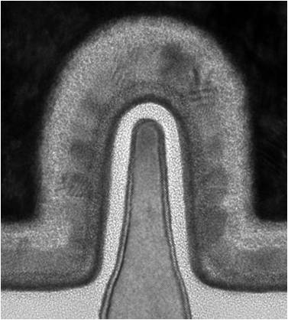
FinFET Transistors (May 2011 and After)
FinFETs
Why is it called that?
What do you think the advantage is?

Slide 24
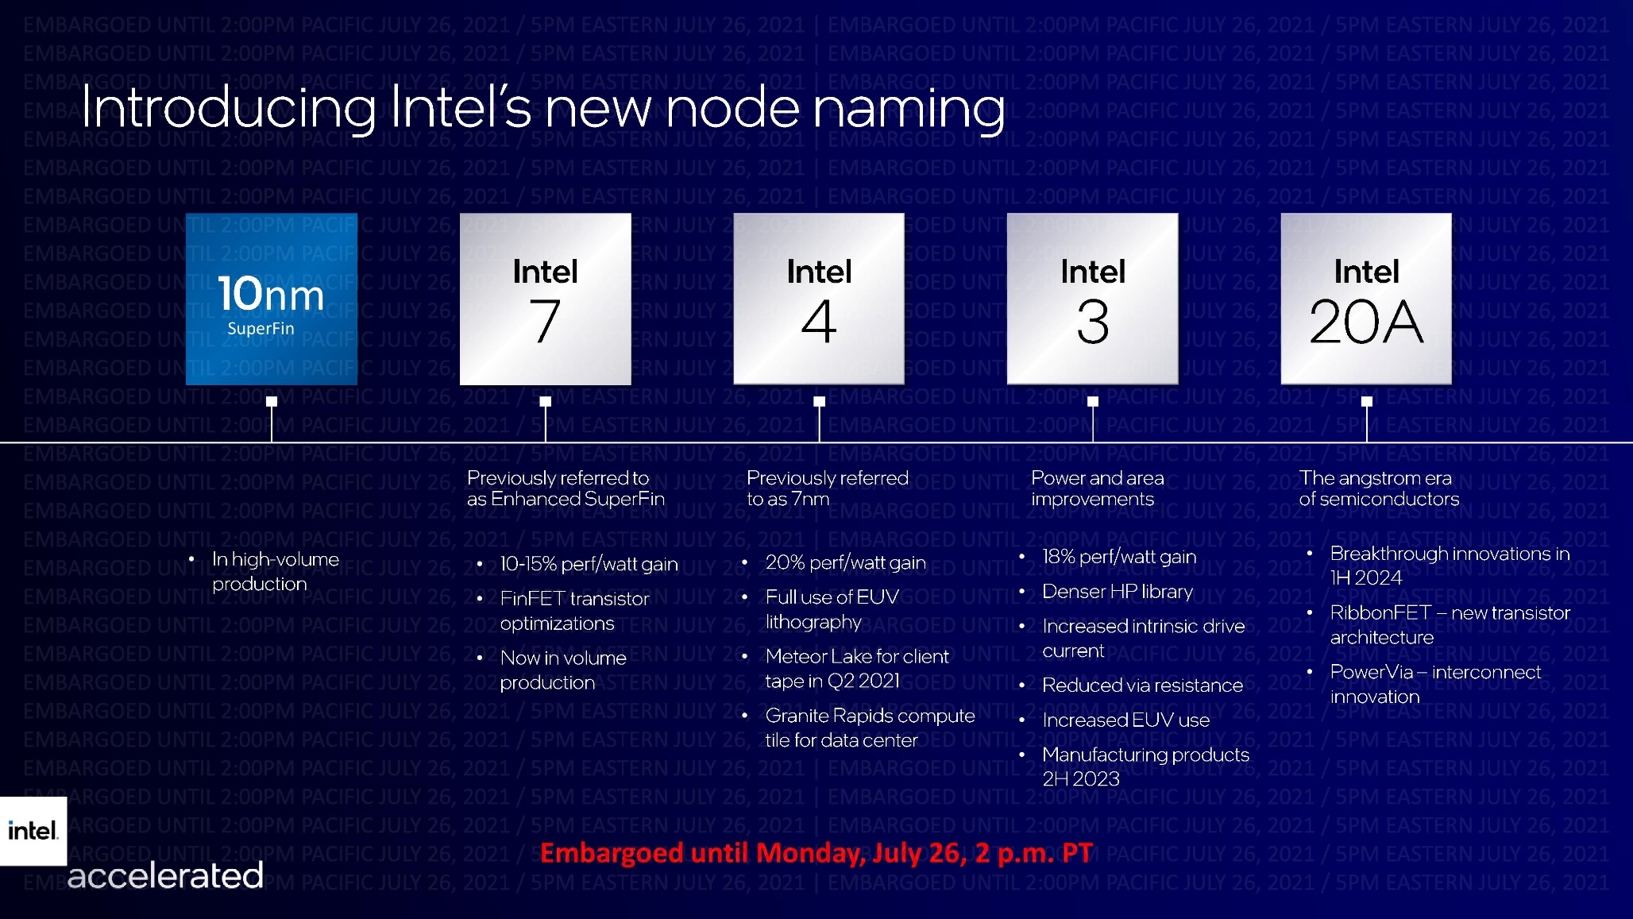
Scaling – How much have we scaled devices?
This is a recent roadmap for Intel’s transistor scaling plans

Slide 25
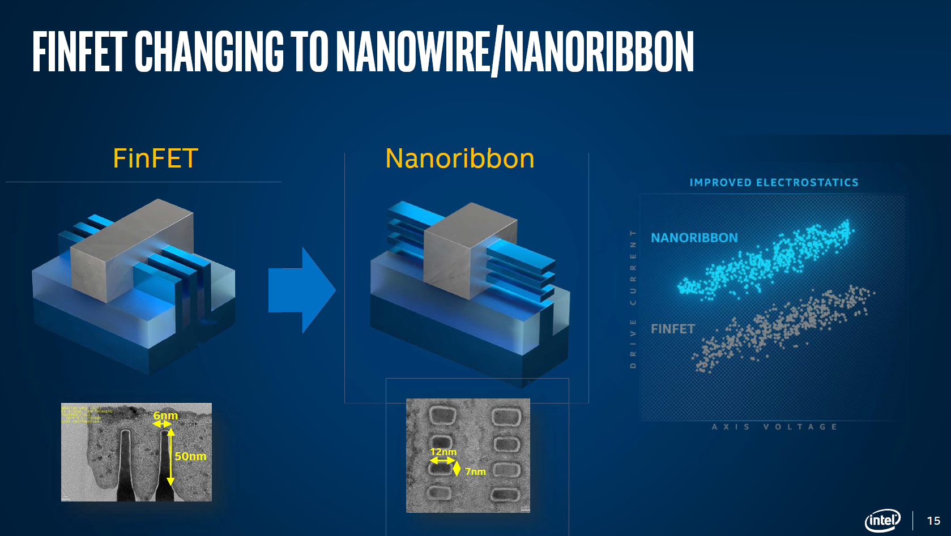
Scaling – How much have we scaled devices?
What is a Nanoribbon FET?
Why does it give better performance?

Slide 26


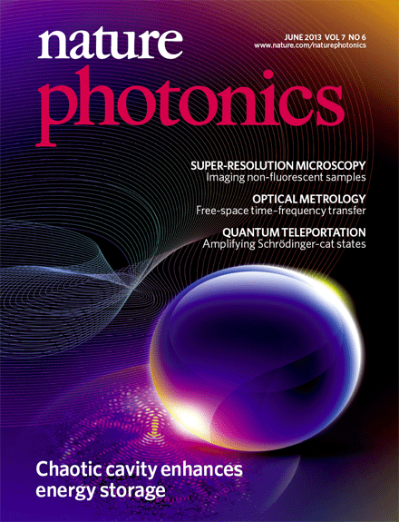

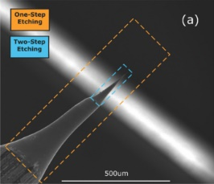
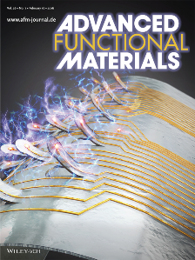
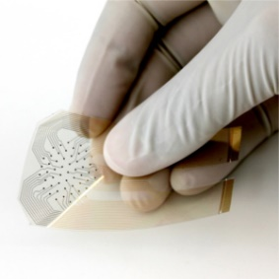
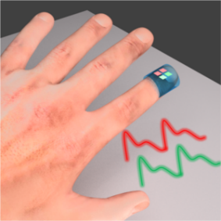

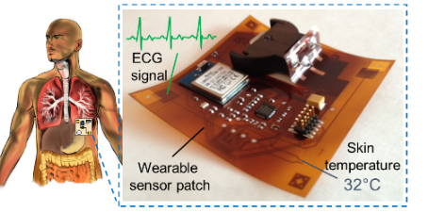
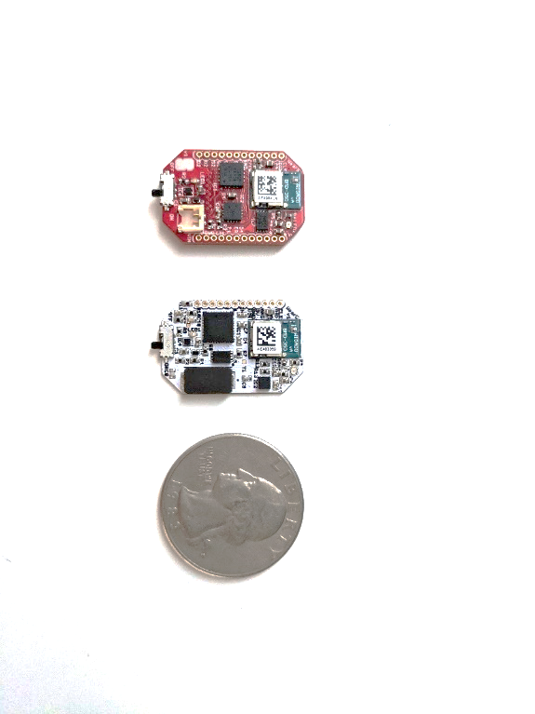
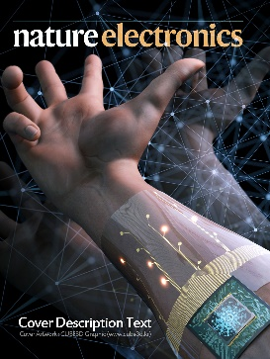

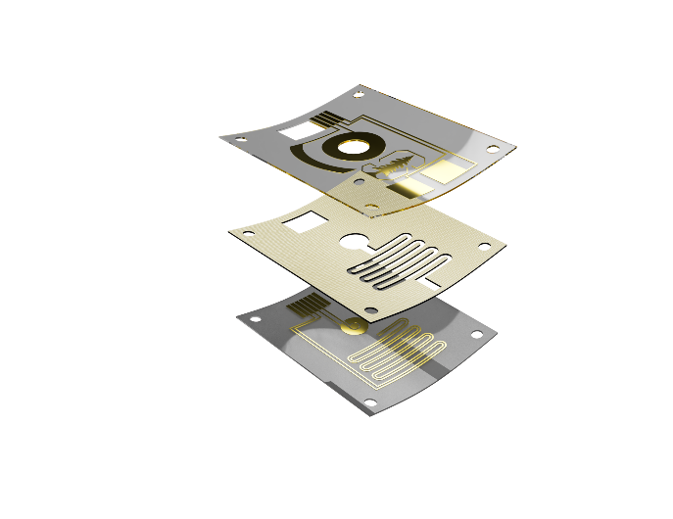
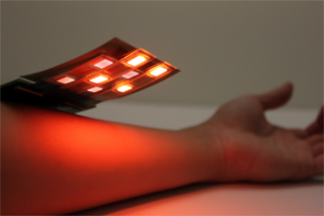
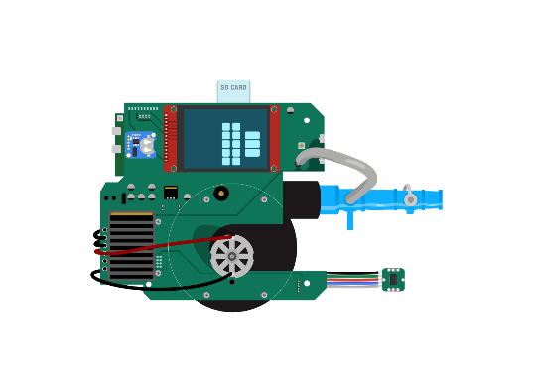
My background and research
Electrical Engineering and Materials Science
BS, EE, 2010
MS, EE, 2012
Started PhD, 2013
Flexible Hybrid Electronics
Bioelectronic and Biophotonic Systems
2016
2015
2014
PhD, EECS, 2018
Started postdoc, 2019
Wearables for precision health and psychiatry
Ventilator for COVID-19

Slide 27
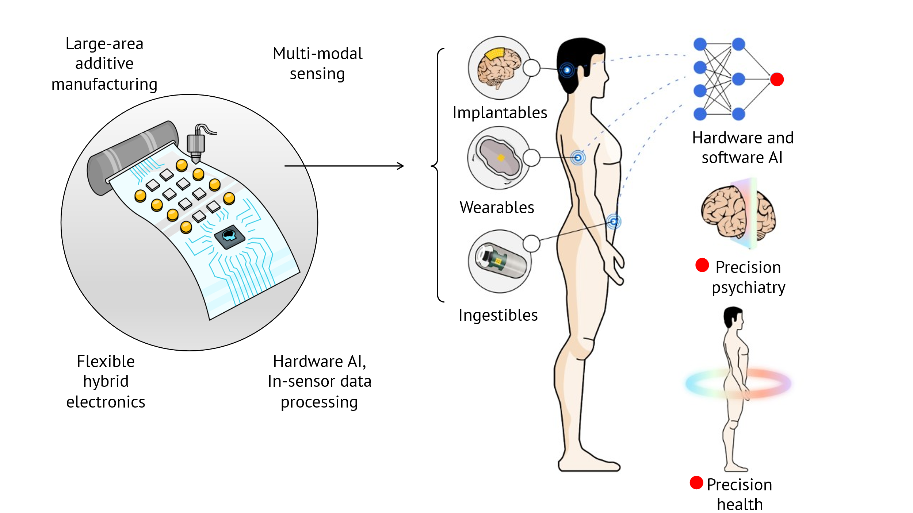
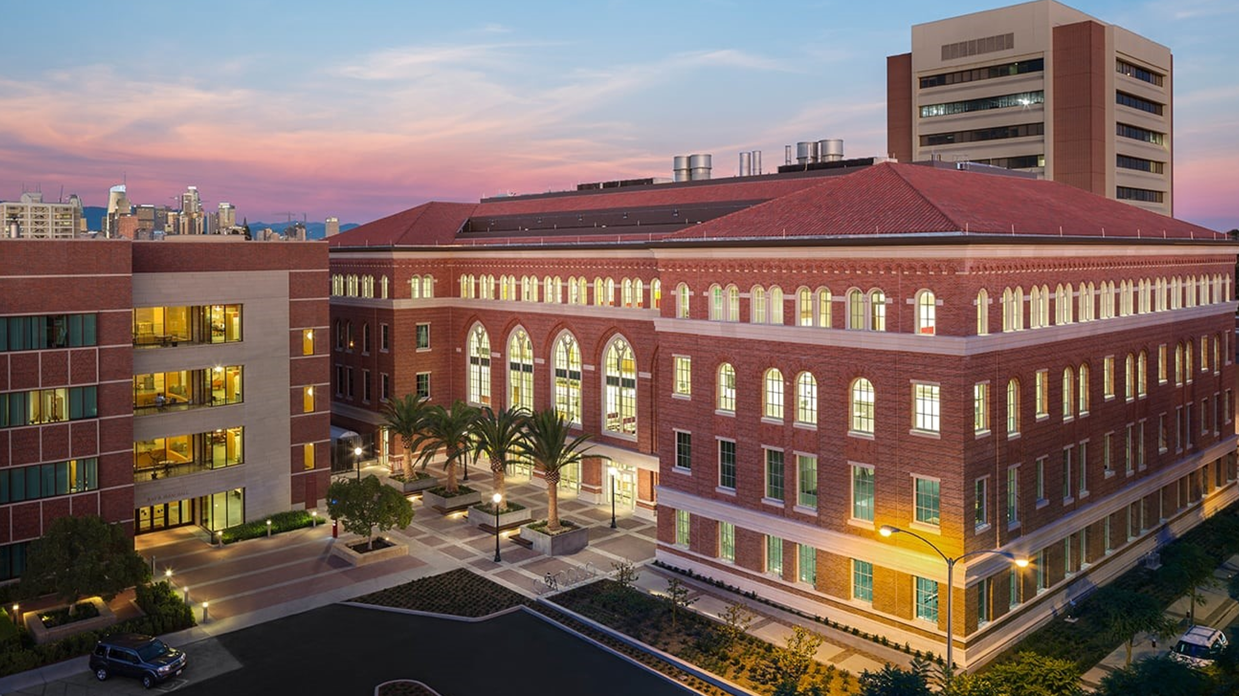

Khan Lab @ USC

Slide 28
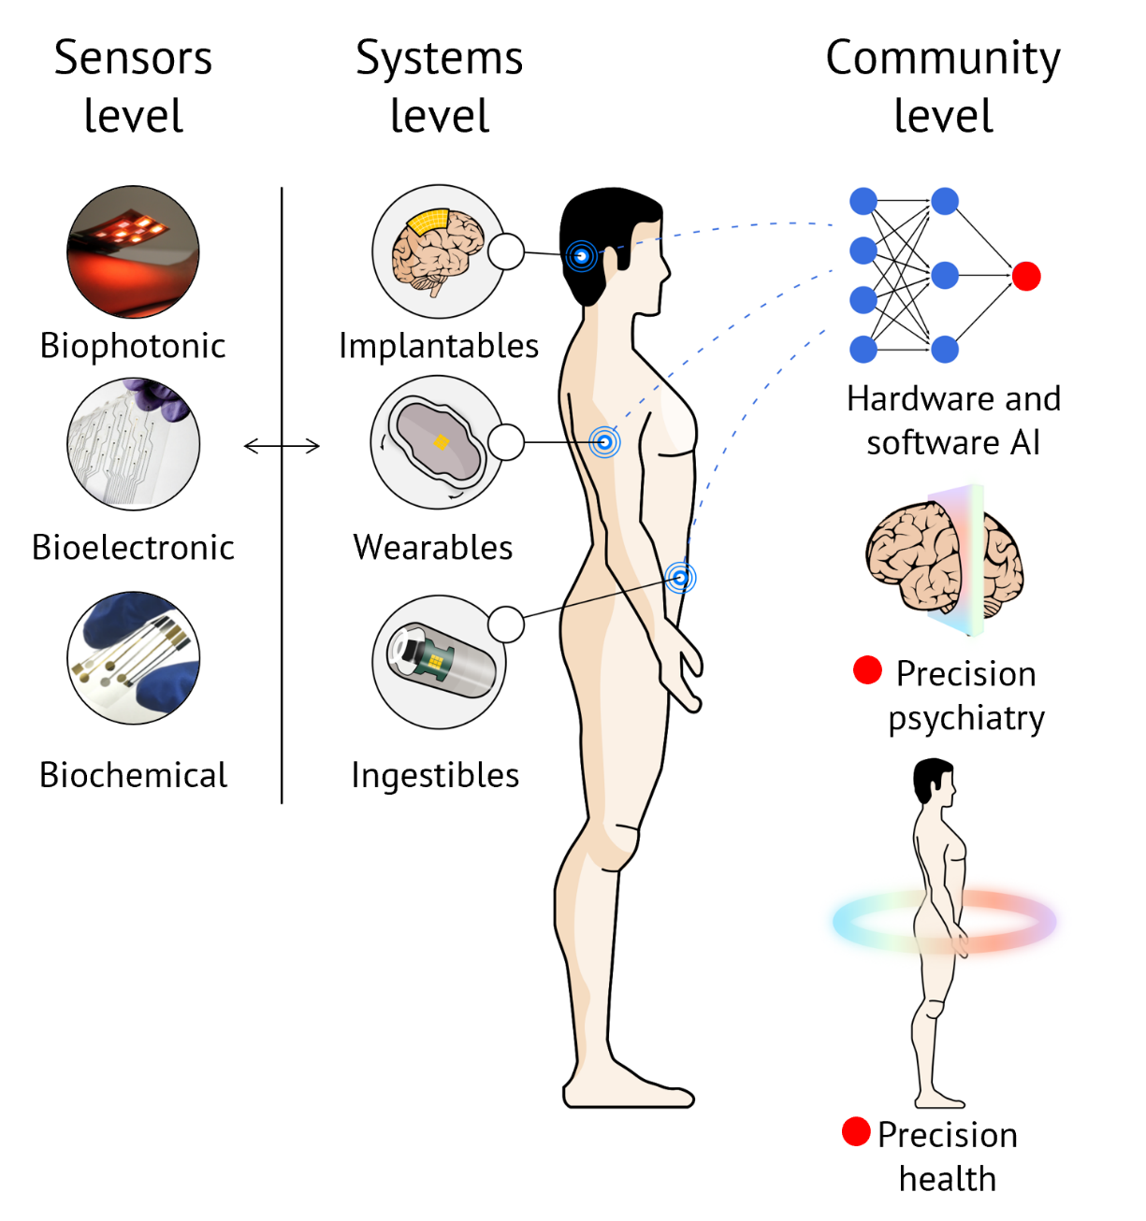
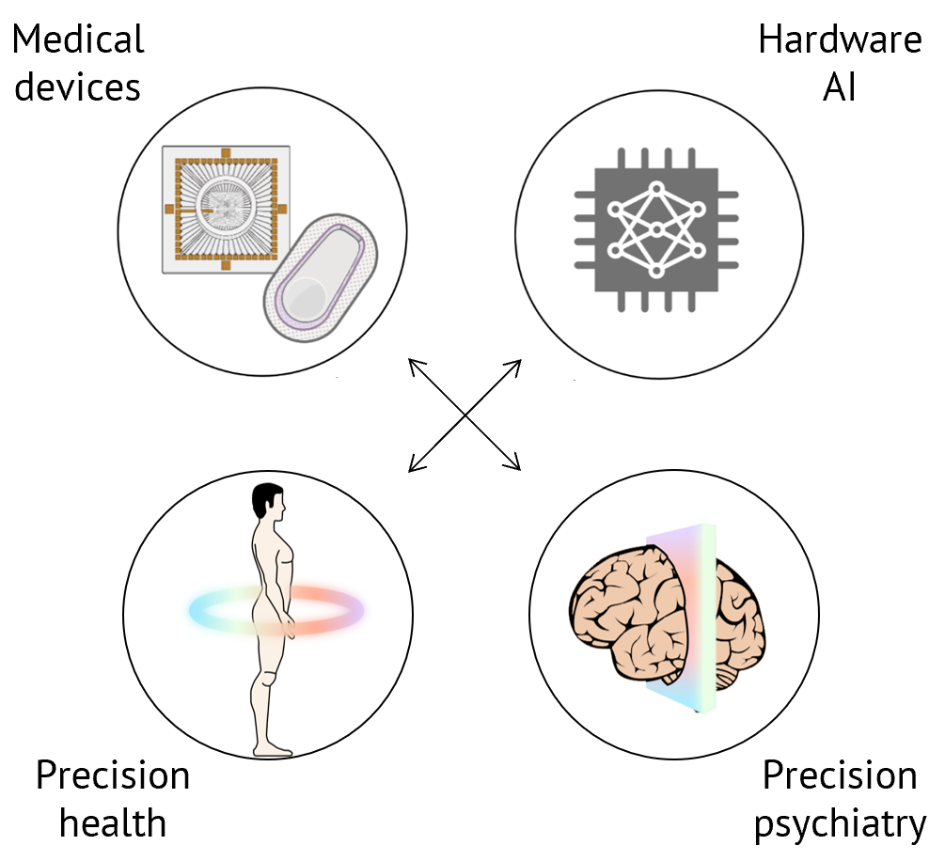
Khan Lab @ USC
Research Focus

Slide 29
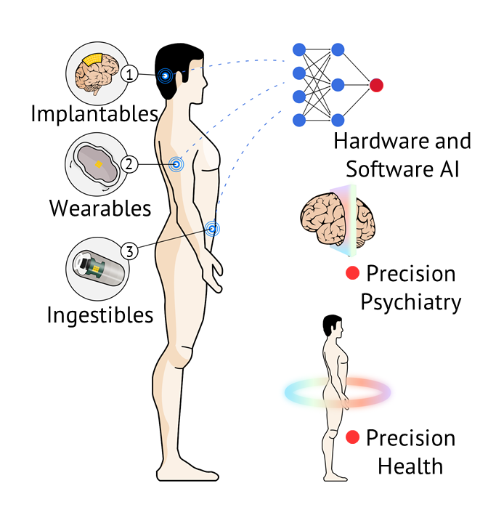
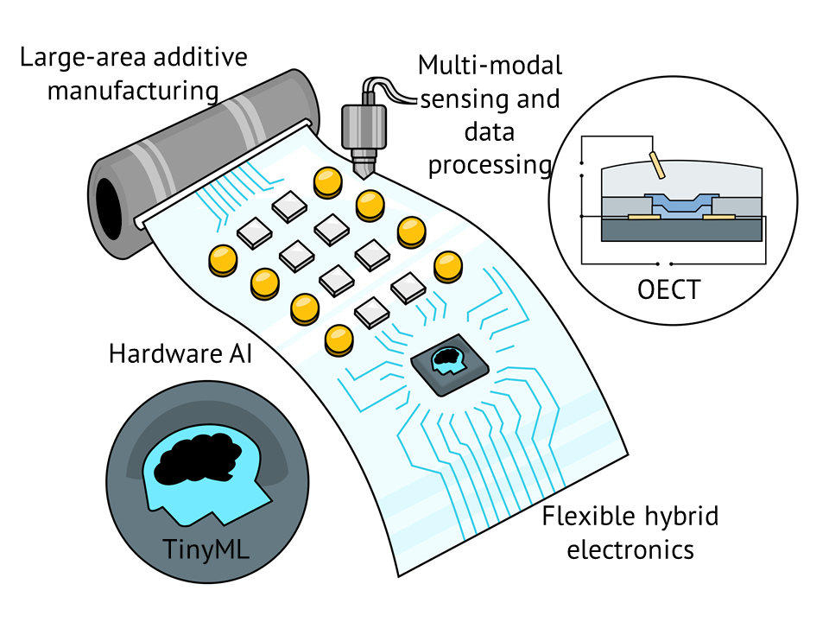
Soft sensor systems for precision health and psychiatry
Materials, Manufacturing, Design, Devices, and Circuits
Systems and Applications

Slide 30
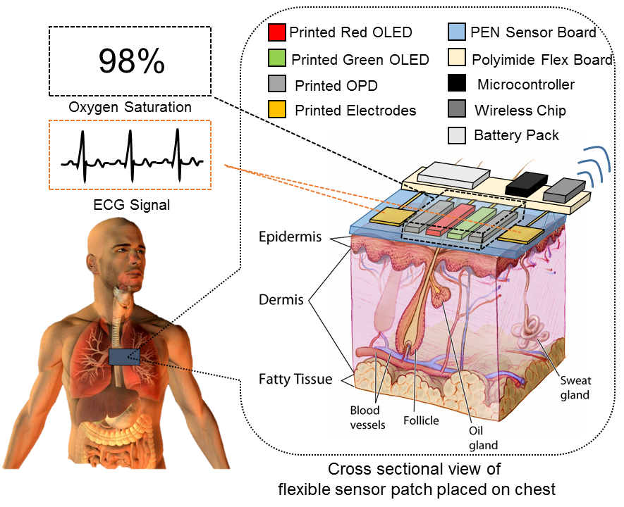
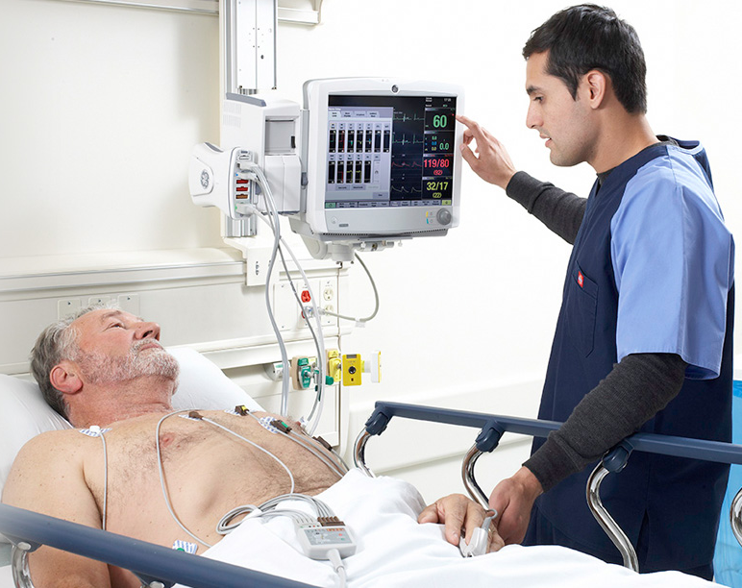
Sensors for precision health and psychiatry
Vision:
A flexible sensor patch that seamlessly measure vital signs - measurements of the body’s most basic functions
Current state:
Big machines with a lot of wired rigid sensors that limits the comfort of the patient

Slide 31
AI-powered biosensor for detecting hand gestures
Biopotential sensing for gesture recognition

Slide 32
Screen-printed MRI receive coils
High-throughput.
Scalable.
Fast.
Significantly less process steps compared to photolithography.
Notes:
This video is a good demonstration of the potential of printed sensors. It shows printing of MRI receive coils.

Slide 33
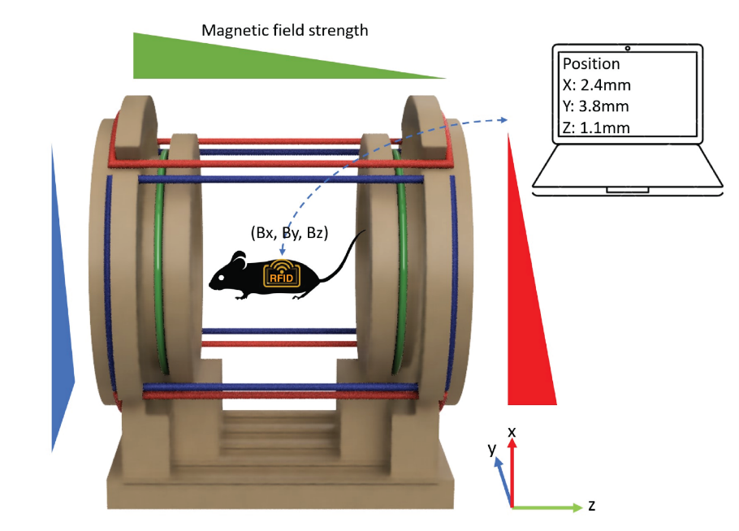
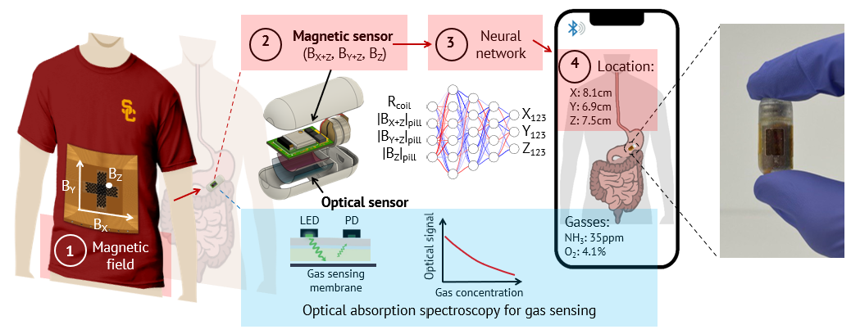
3D gas mapping in the gut with AI-enabled ingestible and wearable electronics
Existing approach: Helmholtz coil for producing a region of nearly uniform magnetic field and localizing ingestible inside the coil.
Our approach: Wearable multi-layer coil for 3D field gradient, and use a bend sensor for accounting for movement.

Slide 34
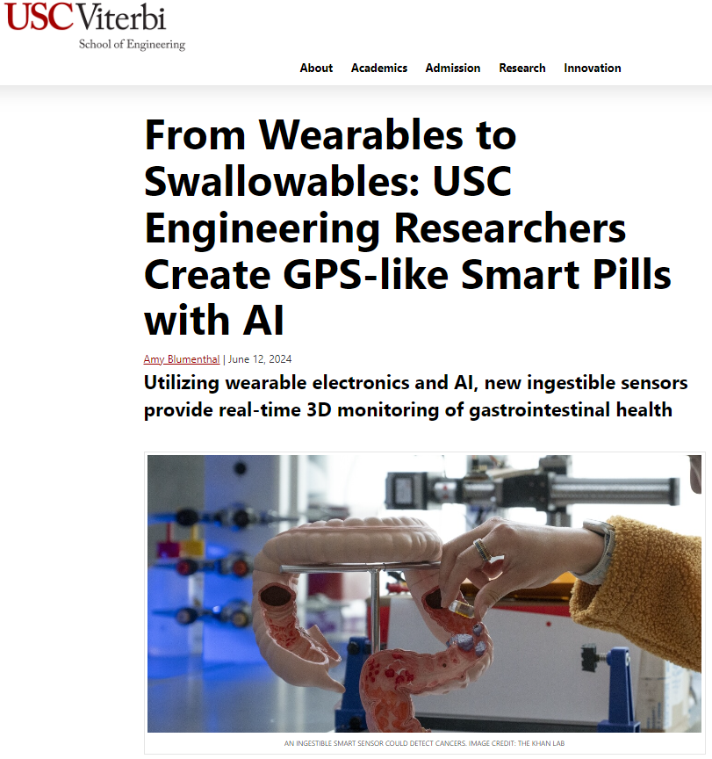
3D gas mapping in the gut with AI-enabled ingestible and wearable electronics

Slide 35













Kapadia Lab Research Portfolio
Back-End Materials Growth and Heterogeneous Integration
Electron Emission Devices for GHz to THz Applications
Ultra-Low Power Computing
100x

Slide 36

John O’Brien Nanofabrication Laboratory
Etch
Deposition
Lithography
Wet Processing
Packaging
Infrastructure
$50M 12,000 Sq. ft. facility
+24,000 sq. ft. automated facility for facilities, gases, and support systems
35+ state-of-the-art cleanroom tools including e-beam and direct write tools, Si and compound semiconductor processing
Sample size from pieces to 100mm (min) and 150mm (subset – but all III-V)
Scalability:
+200 users (2024) with expansion to +500 users planned. The lab can handle 100 active users.
Space available within current facility for additional capacity and capability

Slide 37


The MOSIS Service: Background and History
The MOSIS Service was founded in 1981 at Information Sciences Institute, Viterbi School of Engineering of University of Southern California
DARPA provided the contract for The MOSIS Service to facilitate the first manufacturing projects for fabless organizations
The MOSIS Service pioneered the Multi-Project Wafer (MPW) model
The MOSIS Service has processed over 60,000 designs at more than a dozen foundries
Customers of The MOSIS Service have included US Government Laboratories, foreign and domestic corporations, and foreign and domestic universities
MOSIS has enabled IC designers to prototype innovative semiconductor designs in CMOS FinFET, FD-SOI, Bulk, III-V Compound, high-voltage BCD, and other specialty processes

Slide 38
















Overview of MOSIS 2.0
Academic Customers
National Lab Customers
Commercial Customers
M2 Engineering Team
MPWs
MPWs & Custom Processes
Commercial Fabs/OSATS
Nanofabs/Low-volume Fabs

Slide 39

Overview of MOSIS 2.0 – MPW Offerings

Slide 40
EE 105 Course objectives
• Understand theoretical and practical concepts in electrical engineering.
• Overview of devices, circuits, systems, and AI/ML tools.
• Design simple biosensor systems from end to end.
• Design imager systems with embedded ML.
• Design and implement electronic systems for given specifications.
Theory
Hands-on EE System design
Hardware
Software
Full-stack electronic system development

Slide 41





Syllabus
Dynamic syllabus: https://drive.google.com/file/d/1HjTI33m4UouCzfoHWDAxYqaWjobf419k/view?usp=sharing
Prof. Yasser Khan
Emails: yasser.khan@usc.edu
Offices: MCB 270D
Prof. Rehan Kapadia
Emails: rkapadia@usc.edu
Offices: PHE 626
Atiyeh Abbasi Jalal
(Teaching Assistant)
Emails: abbasija@usc.edu
Vikas Addepalli (Course Mentor)
Emails: daddepal@usc.edu
Walter Unglaub
(Research Engineer)
Emails: unglaub@usc.edu

Slide 42
Course structure
Lectures and discussions are sufficient for homework and final exam
Emphasis on practical learning
Homework to review major concepts
Homework | 30% (6)
Mid | 30% (October 17, Thursday )
Final | 40% (December 12, 2-4pm, cumulative)

Slide 43
Approximate schedule
Course homepage: https://brightspace.usc.edu/d2l/home/114204
6 homework assignments
Final in finals week
Mid October 17 in class
HW 1
HW 6
Final
Mid

Slide 44

Course content
6 homeworks are on 6 modules
Circuits
Devices
Systems
Linear algebra
Neural network
Communication systems
Midterm will cover circuits, devices, and biosensing systems
Final will cover everything.

Slide 45


Custom demonstration board for EE 105
Arduino Nano 33 BLE
Electronic devices
Diodes
Transistors
Circuits
Voltage dividers
Module 2: Devices
Arduino
Electronic systems
Optical communication system
Oximeter
Module 3: Systems
Machine vision
Module 1: Circuits
Module 4: TinyML

Slide 46


Module 1 on circuits – demo resistive touchscreen
Finds the pressed button location automatically

Slide 47

Module 2: diodes and transistors
Characterize semiconductor diode – how do they work

Slide 48

Module 2: diodes and transistors
Characterize semiconductor transistors – how do they work
Current through the transistors
Increasing gate voltage / opening faucet in the water analogy

Slide 49


Module 3: optical communication
Light on
Light off

Slide 50

Module 3: oximeter

Slide 51

Module 3: oximeter

Slide 52



Module 4: Machine vision
Goal
ECE 105
Arduino + camera + ML = identify objects / letters / faces / anything

Slide 53

Next lecture: system design

